Slide 1
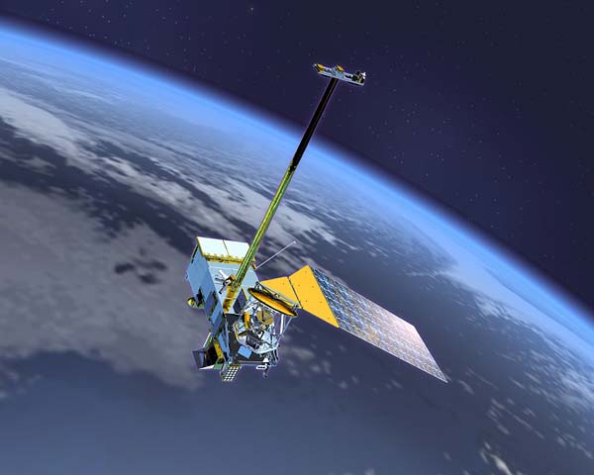

Moving Climate Data Records from
Research to Operations
John Bates, Jeff Privette, Tom Karl, National Climatic Data Center (NCDC) NOAA
Jack Kaye NASA
Bryant Cramer USGS

Slide 2
Outline
Motivation for Climate Data Records (CDRs)
Context and Content of a Systematic Project
Notional Research-to-Operations Flow
SDS Project Organization

Slide 3
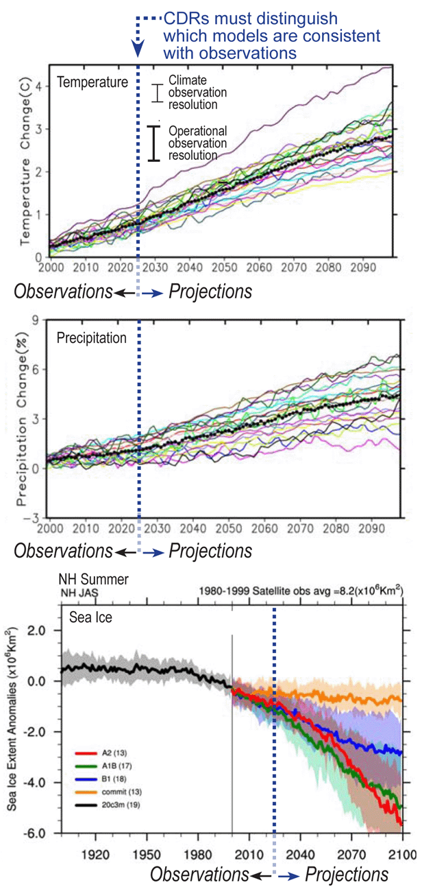
Long Term Records are Needed to Determine True IPCC Projection
*
IPCC model projections for temperature, precipitation, and sea ice vary greatly
Mitigation and adaptation strategies depend critically on identifying which models are best
Only high quality, sustained CDRs can validate climate model projections into the decades ahead
*Resolution scale in Panel 1 is notional only.

Slide 4
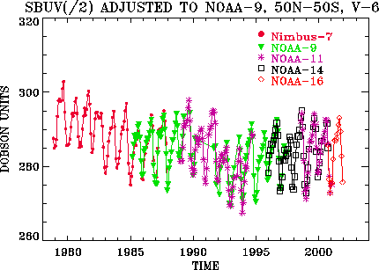
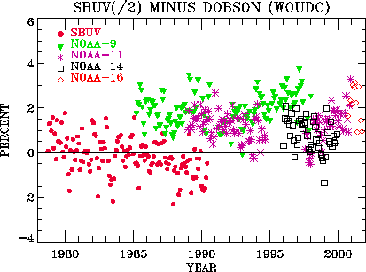
Ozone CDR Used To Validate Models and Verify International Treaties
Ozone is adjusted to NOAA-9
Validated against Dobson Stations
Reprocessed when new algorithms are developed by joint NOAA/NASA team
Compared with models

Slide 5
Weather vs. Climate Processing
Distinct Paths, Technologies, and Timelines
Data (Direct & Remotely Sensed)
Time-tagged
Geo-Referenced
New CDR Initiative
Sensor Data
Records (SDRs)
Converted to
Bio-Geophysical Variables
Homogenization
and Calibration
Homogenization
and Calibration with heritage data sets
Environmental
Data Records
(EDRs)
Fundamental Climate Data Records (FCDRs)
Climate
Data
Records or Homogenized Time
Series
Converted to
Bio-Geophysical Variables
Thematic Climate
Data Records (TCDRs)
Operational
and
Mature
Climate Information Records (CIRs)

Slide 6
Scientific Data Stewardship (SDS)
Scientific Data Stewardship is a systematic approach to observation, production, and preservation of essential climate information
  Primary Outputs
    Climate Data Records (CDRs)
    Climate Information Records (CIRs)

Slide 7
“Remanifestation” Study Provided Chance to Address Climate Science Needs from NPOESS
NOAA has been providing Operational Climate Services through the National Climatic Data Center (NCDC) and the Climate Prediction Center (CPC) for many years (mainly focused on in situ data)
NCDC has recently participated in a Joint NASA-NOAA Working Group to restore climate sensors to NPOESS (following the Nunn-McCurdy restructure) and to begin operational production of satellite CDRs (beginning in FY09)
  NOAA’s FY 2009 Passback included $74M to mitigate the loss of climate sensors on NPOESS and to provide long term Climate Data records

Slide 8
Joint-Agency CDR Program Goals
Incorporate NRC input
Devise and cost an end-to-end program
  CDRs and Climate Information Records (CIRs)
  Stakeholder-driven
  Systematic
  Comprehensive (GCOS, IPCC, NRC, CCSP, etc.)
  Sustainable
Build on current investments and expertise
  Interagency and International

Slide 9
Basis for Systematic R2O Transitioning
CDRs develop through overlapping Research (RM) and Operational Missions (OM)
  Joint agency cooperation on all science & applications of each mission
Research-to-Operations occurs as function of CDR maturity
  Developed 6-Level Maturity Matrix to define path
  Not all sensor products will become Level 6 CDRs
  Research programs continue developing algorithm alternatives and advancements to challenge “released” Level 6 CDRs
3 community groups coordinate and manage CDR evolution
  Working Group: Science team plans and executes development of CDR (1 per CDR subset)
  CDR Science Advisory Board: Senior climate scientists review and prioritize CDR planning and development
  Steering Committee: Government senior scientists and managers coordinate budgetary matters and research-to-operations transitions

Slide 10
CDR Maturity Matrix Help Identify Next Steps and Agency Roles
Maturity | Sensor Use | Algorithm stability | Metadata & QA | Documentation | Validation | Public Release | Science & Applications
1 | Research Mission | Significant changes likely | Incomplete | Draft ATBD | Minimal | Limited data availability to develop familiarity | Little or none
2 | Research Mission | Some changes expected | Research grade (extensive) | ATBD Version 1+ | Uncertainty estimated for select locations/times | Data available but of unknown accuracy; caveats required for use. | Limited or ongoing
3 | Research Missions | Minimal changes expected | Research grade (extensive); Meets international standards | Public ATBD; Peer-reviewed algorithm and product descriptions | Uncertainty estimated over widely distribute times/location by multiple investigators; Differences understood. | Data available but of unknown accuracy; caveats required for use. | Provisionally used in applications and assessments demonstrating positive value.
4 | Operational Mission | Minimal changes expected | Stable, Allows provenance tracking and reproducibility; Meets international standards | Public ATBD; Draft Operational Algorithm Description (OAD); Peer-reviewed algorithm and product descriptions | Uncertainty estimated over widely distribute times/location by multiple investigators; Differences understood. | Data available but of unknown accuracy; caveats required for use. | Provisionally used in applications and assessments demonstrating positive value.
5 | All relevant research and operational missions; unified and coherent record demonstrated across different sensors | Stable and reproducible | Stable, Allows provenance tracking and reproducibility; Meeting international standards | Public ATBD, Operational Algorithm Description (OAD) and Validation Plan; Peer-reviewed algorithm, product and validation articles | Consistent uncertainties estimated over most environmental conditions by multiple investigators | Multi-mission record is publicly available with associated uncertainty estimate | Used in various published applications and assessments by different investigators
6 | All relevant research and operational missions; unified and coherent record over complete series; record is considered scientifically irrefutable following extensive scrutiny | Stable and reproducible; homogeneous and published error budget | Stable, Allows provenance tracking and reproducibility; Meeting international standards | Product, algorithm, validation, processing and metadata described in peer-reviewed literature | Observation strategy designed to reveal systematic errors through independent cross-checks, open inspection, and continuous interrogation | Multi-mission record is publicly available from Long-Term archive | Used in various published applications and assessments by different investigators

Slide 11
Project Office Organization and Relationships
Legend
NESDIS
NOAA Science
Advisory Board
NASA Science
Advisory Board
NCDC
Other NOAA
Climate Instruments
and Records
Federal
Academia/Industry
CDR Joint
Working Group
Cooperative Inst.
Climate Instrument
Acquisition Project
Climate Record
Project
Manager: J. Privette (Acting)
NASA
CDR Coordination
Committee
Research &
Early
Development
Research
Agencies
Project
Scientist
H. Zhang (Acting)
Chief Engineer
D. Saunders
(Acting)
ERAD
(Contracts)
Business
Management
L. Statler (Acting)
Grants
Activity
Management
Climate Record
Production & Validation
IT Architecture
and Systems Engineering
(Possibly Distributed)
Project Management
STAR/
GSICS
Sensor
Characterization
Support Team
Product
Support Team
Hardware and
Networks
Software and
Standards
Calibration
Working Group
(Sensor x)
Characterization
Working Group
(FCDR x)
CDR Working
Group
(TCDR x)
CIR Working
Group
(Product x)
Standards
Working Group
(Standard x)
Execution
(Algorithm Generalization and Maintenance,
CDR Production and Validation)
Development Stage

Slide 12
Thanks

