Slide 1
V-MOD BUSINESS MEETING
Montréal, CANADA
FRIDAY 12th July 2019

Slide 2
AGENDA
Acceptance of draft agenda
Report on IGRF-12 and Evaluation
Status on WDMAM
Status of data available for IGRF-13 field modelling.
Presentation of IGRF-13 task force.
IGRF-13 specification and call
  Coefficient uncertainties
Election of DIV-VMOD chair and co-chair
Suggestions for sessions at IAGA/IASPEI 22-27 August 2021, Hyderabad, India.
Any other business ?

Slide 3
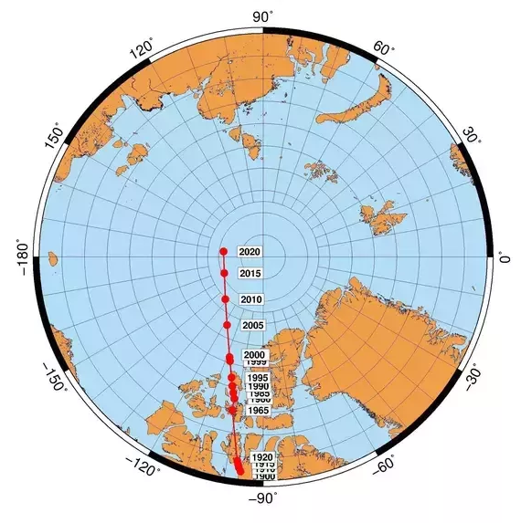
Report on IGRF-12

Slide 4
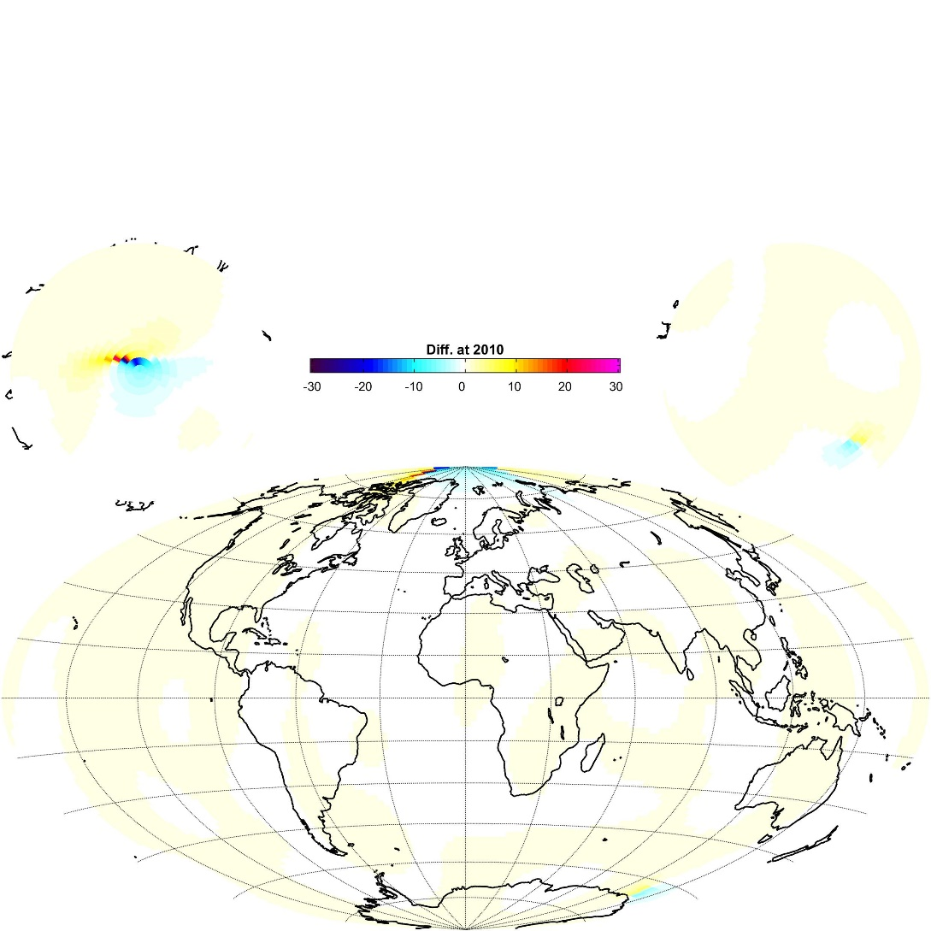
Difference with CHAOS
Difference between IGRF and CHOAS for the declination in degrees.

Slide 5
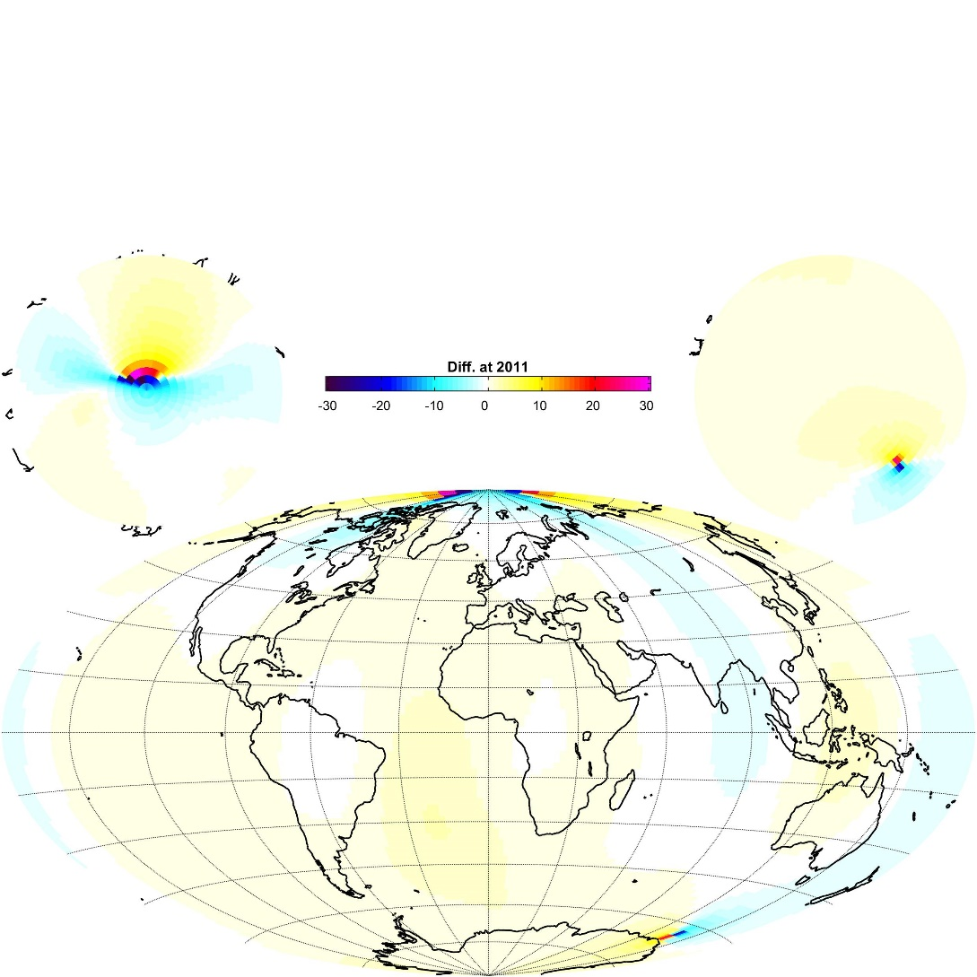
Difference with CHAOS
Difference between IGRF and CHOAS for the declination in degrees.

Slide 6
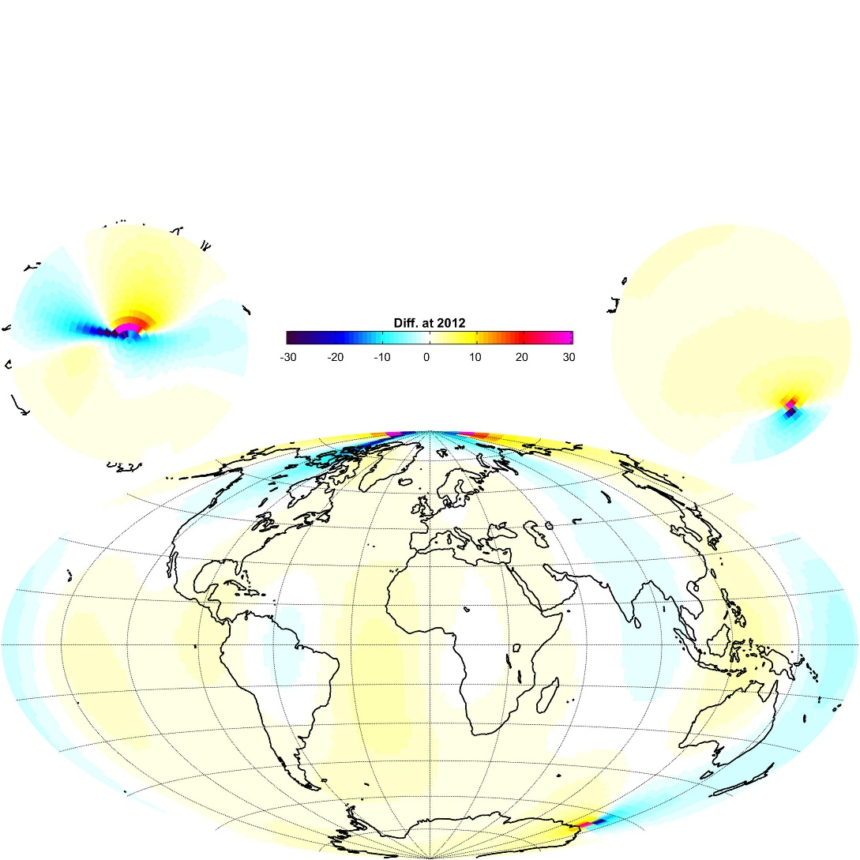
Difference with CHAOS
Difference between IGRF and CHOAS for the declination in degrees.

Slide 7
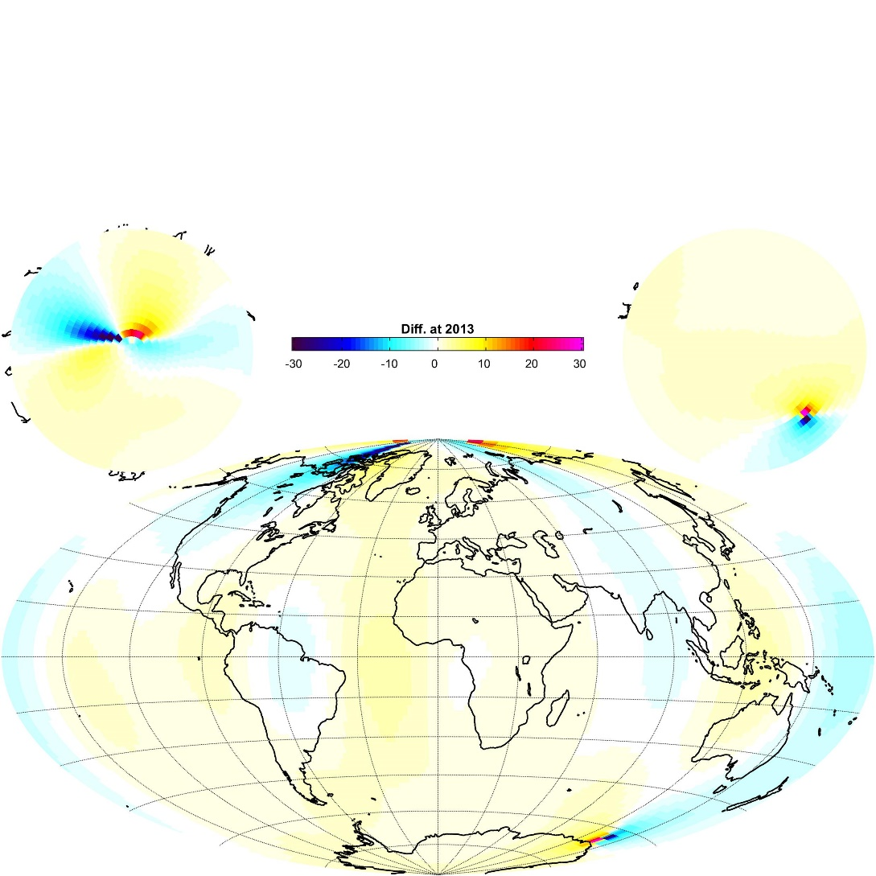
Difference with CHAOS
Difference between IGRF and CHOAS for the declination in degrees.

Slide 8
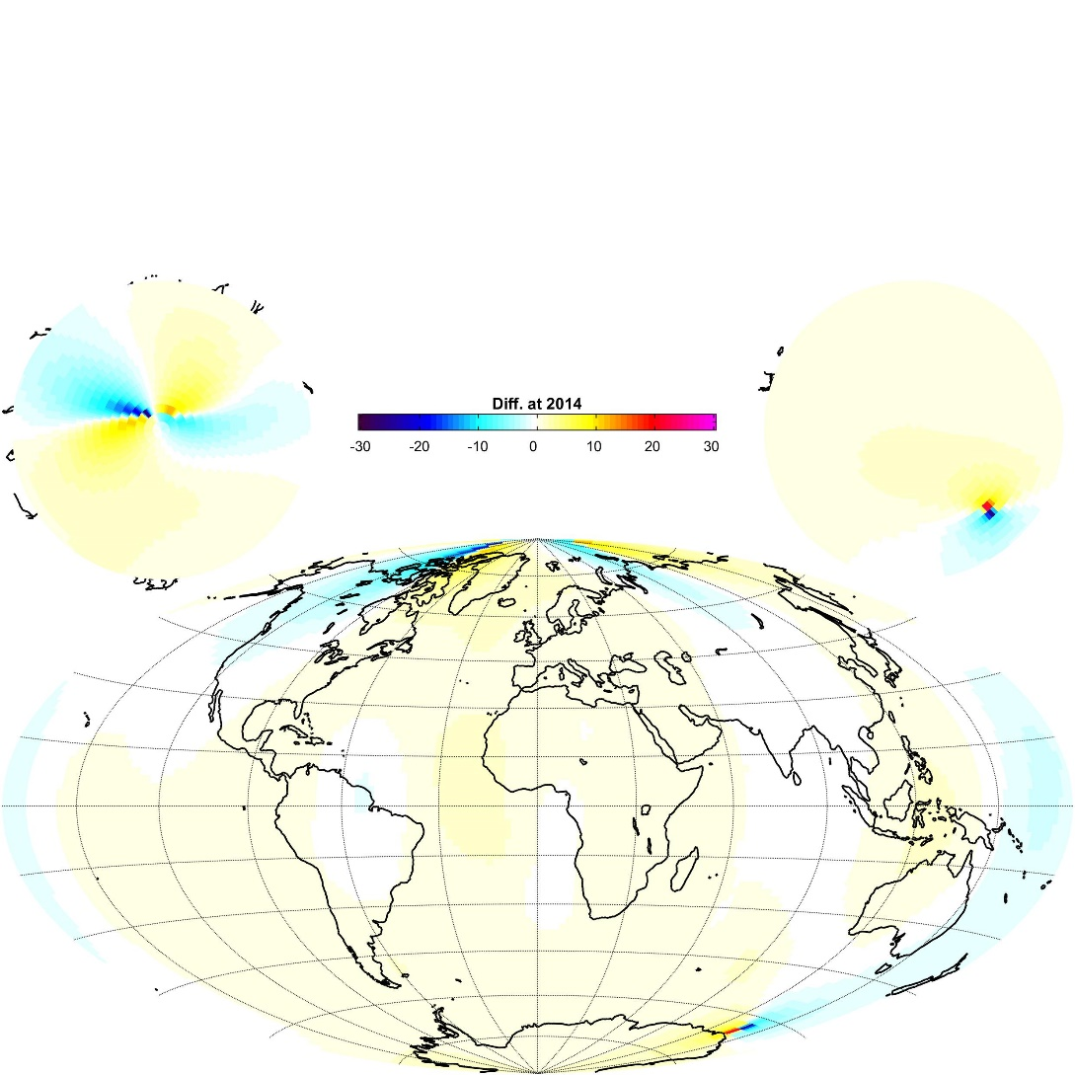
Difference with CHAOS
Difference between IGRF and CHOAS for the declination in degrees.

Slide 9
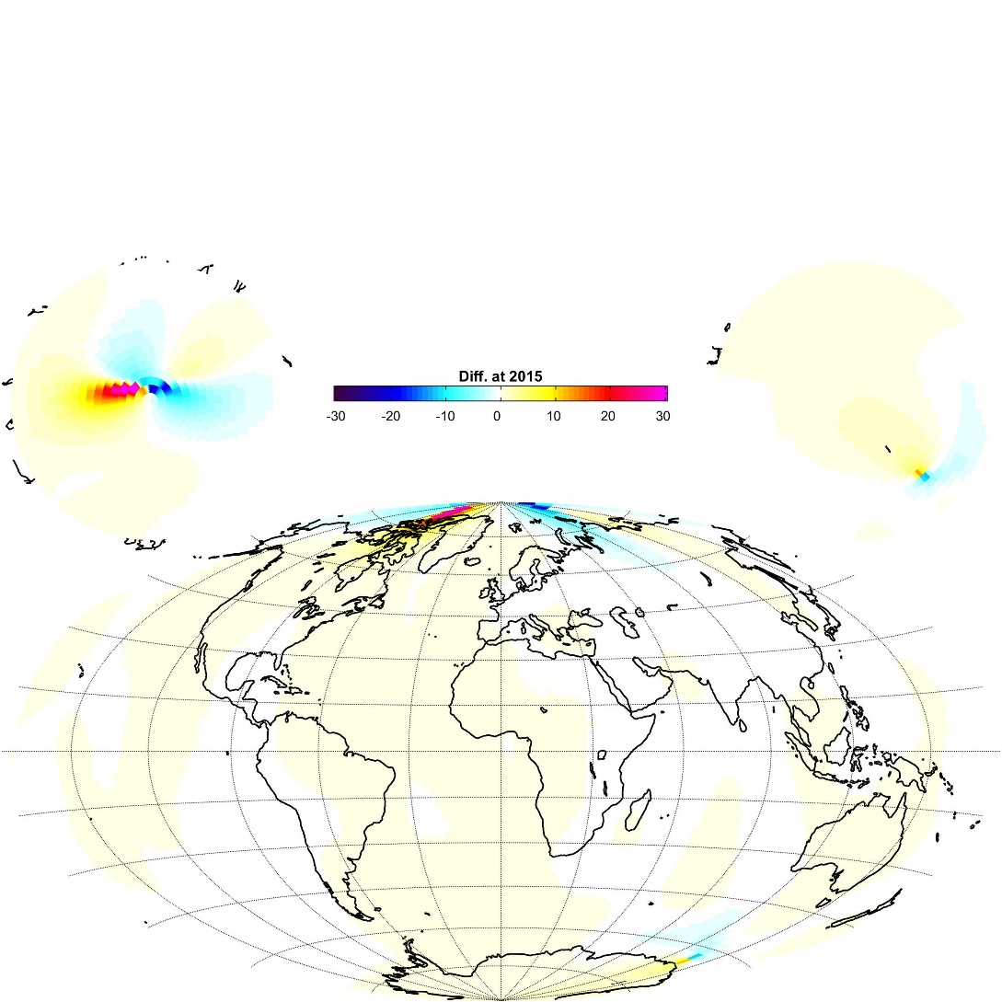
Difference with CHAOS
Difference between IGRF and CHOAS for the declination in degrees.

Slide 10
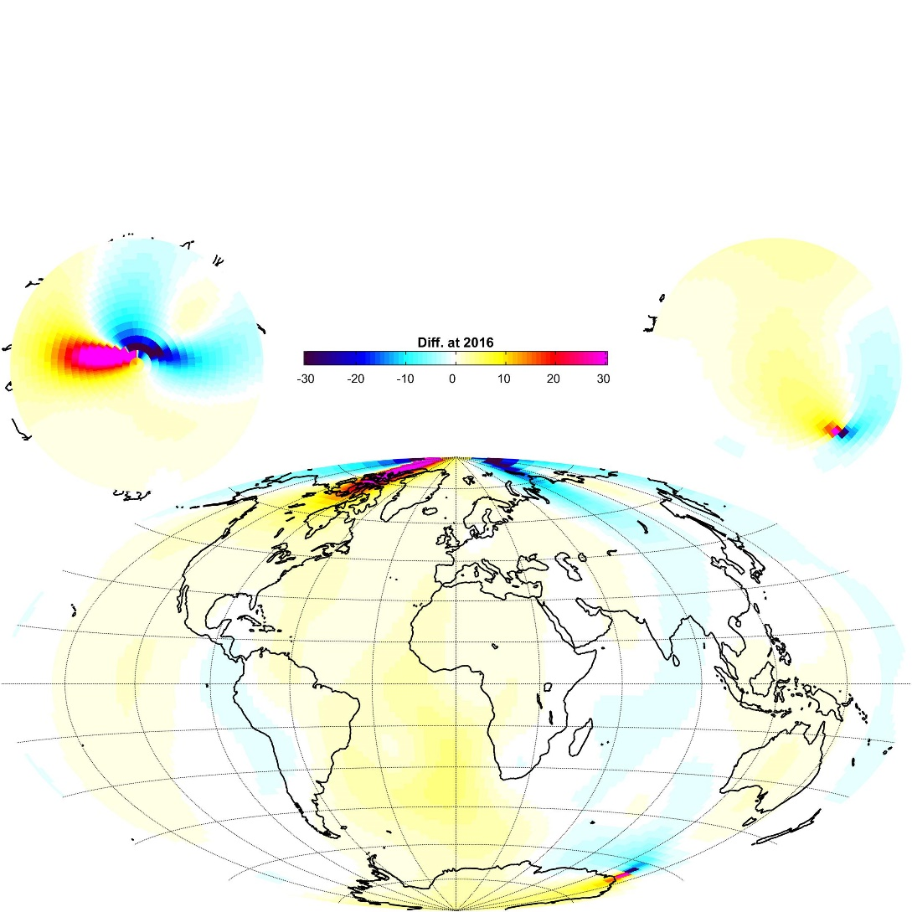
Difference with CHAOS
Difference between IGRF and CHOAS for the declination in degrees.

Slide 11
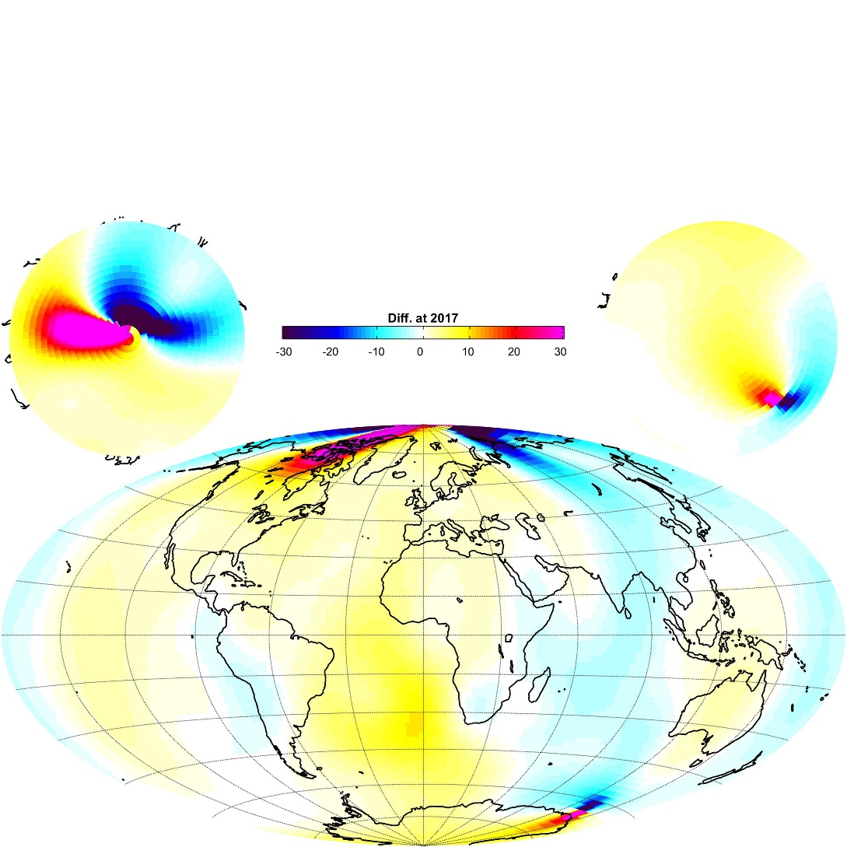
Difference with CHAOS
Difference between IGRF and CHOAS for the declination in degrees.

Slide 12
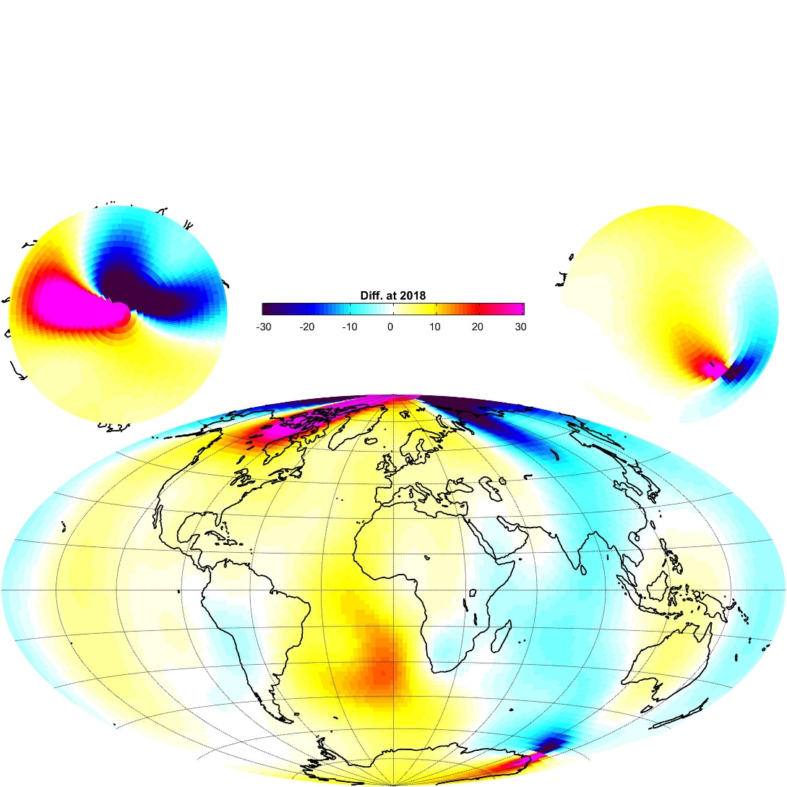
Difference with CHAOS

Slide 13
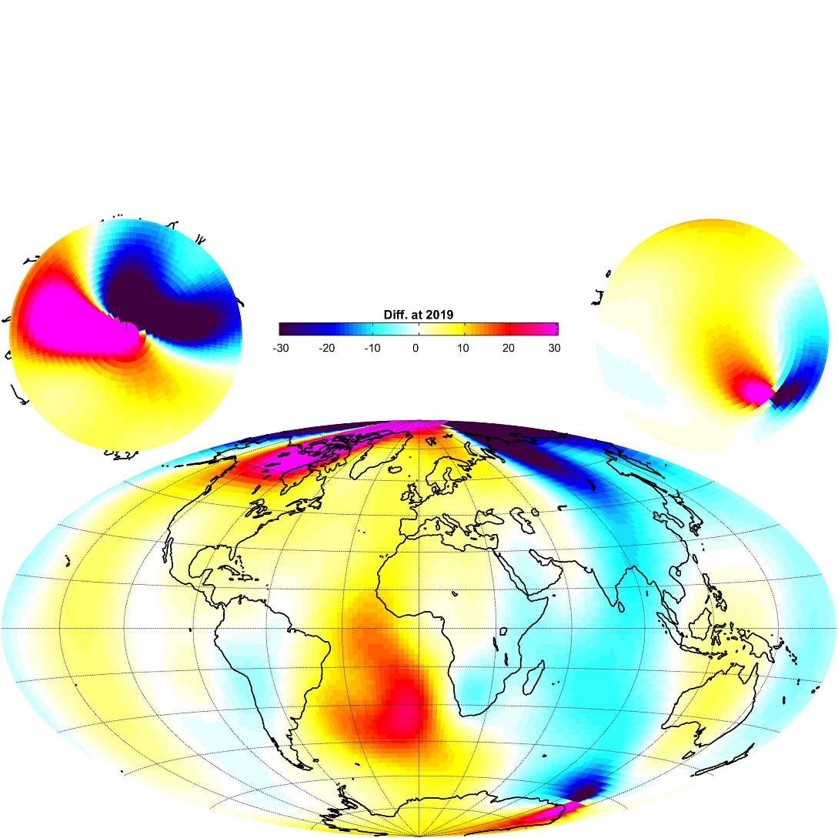
Difference with CHAOS
Difference between IGRF and CHOAS for the declination in degrees.

Slide 14
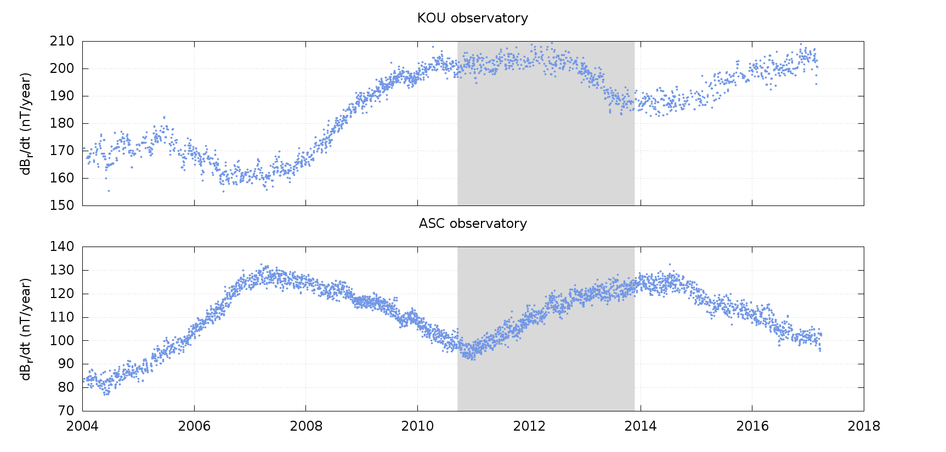
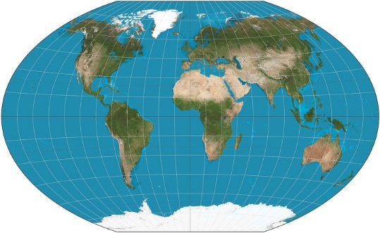
Late 2014 geomagnetic jerk
Gap in satellite coverage
CHAMP
Swarm

Slide 15
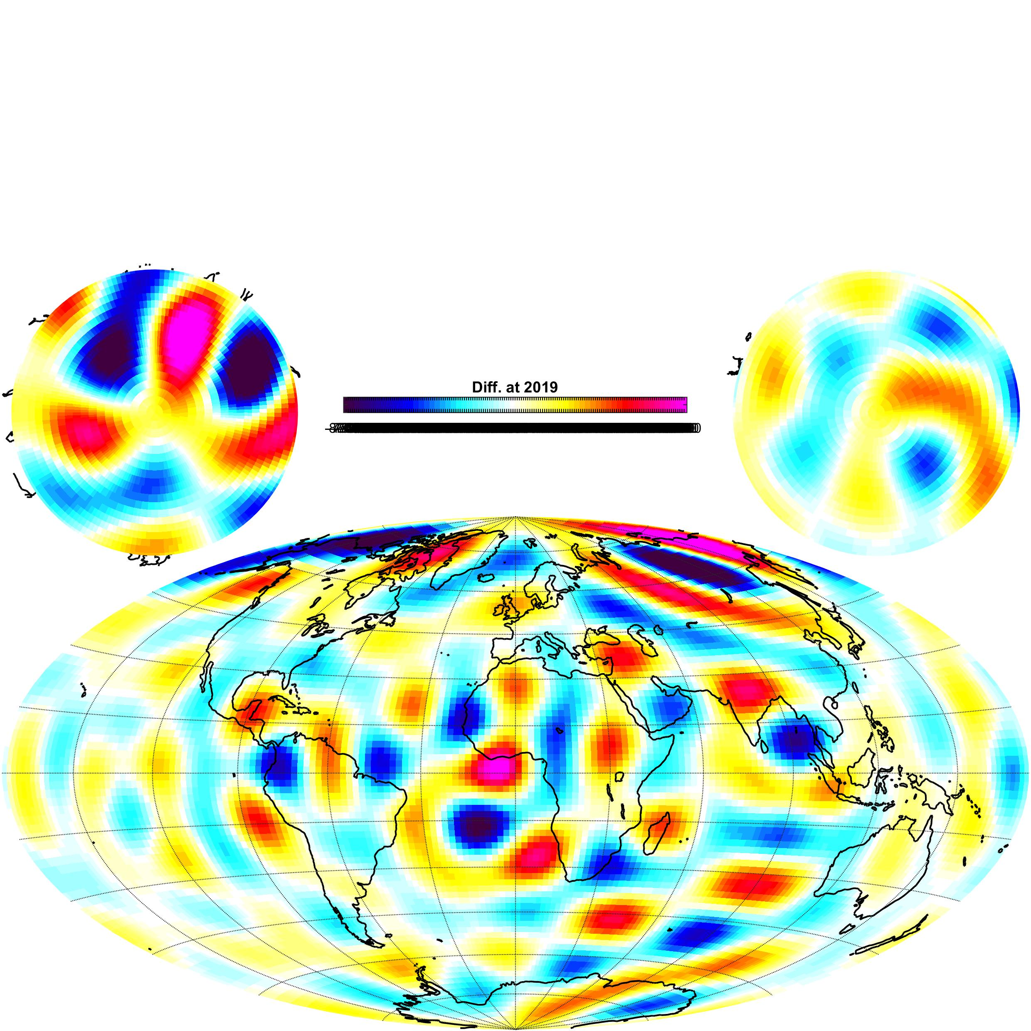
Difference with CHAOS at the CMB
Radial component at the CMB

Slide 16
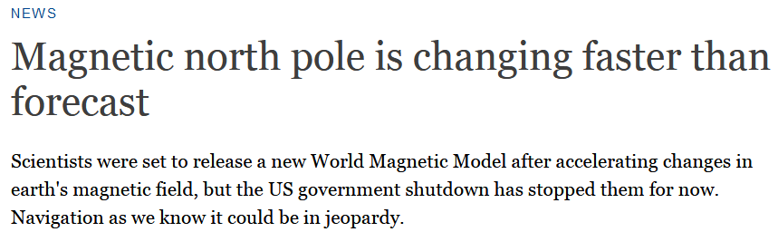
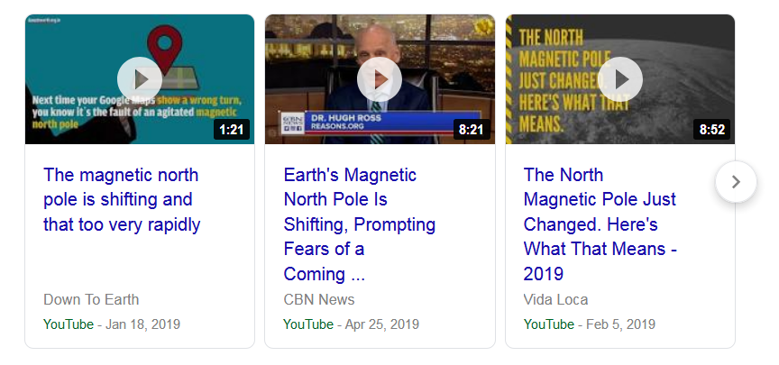
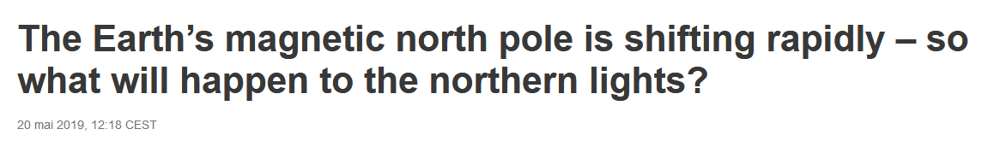
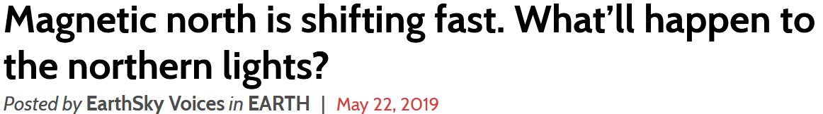
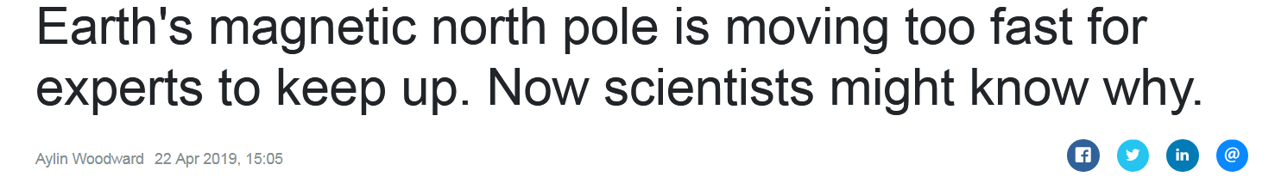
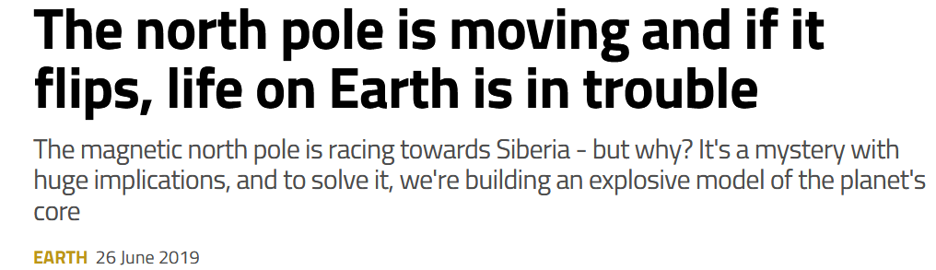
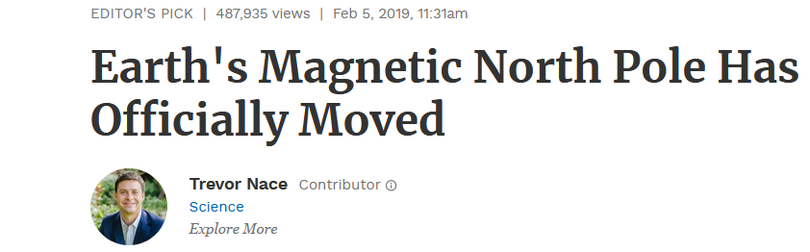
Velocity of the dip poles

Slide 17
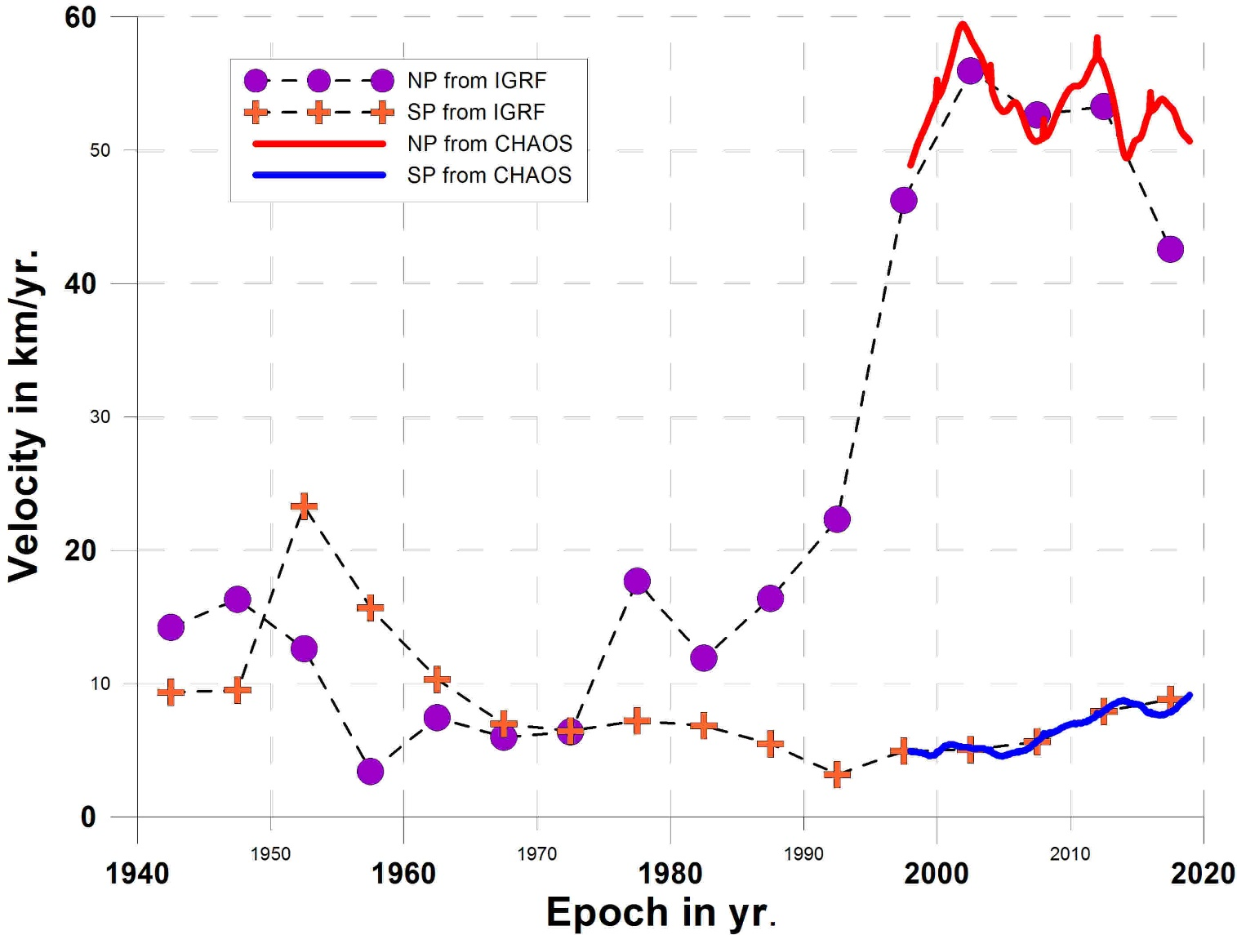
Velocity of the dip poles
The speed of the North dip pole is globally decreasing slightly since epoch 2002
Figure updated from Thébault et al., 2015

Slide 18
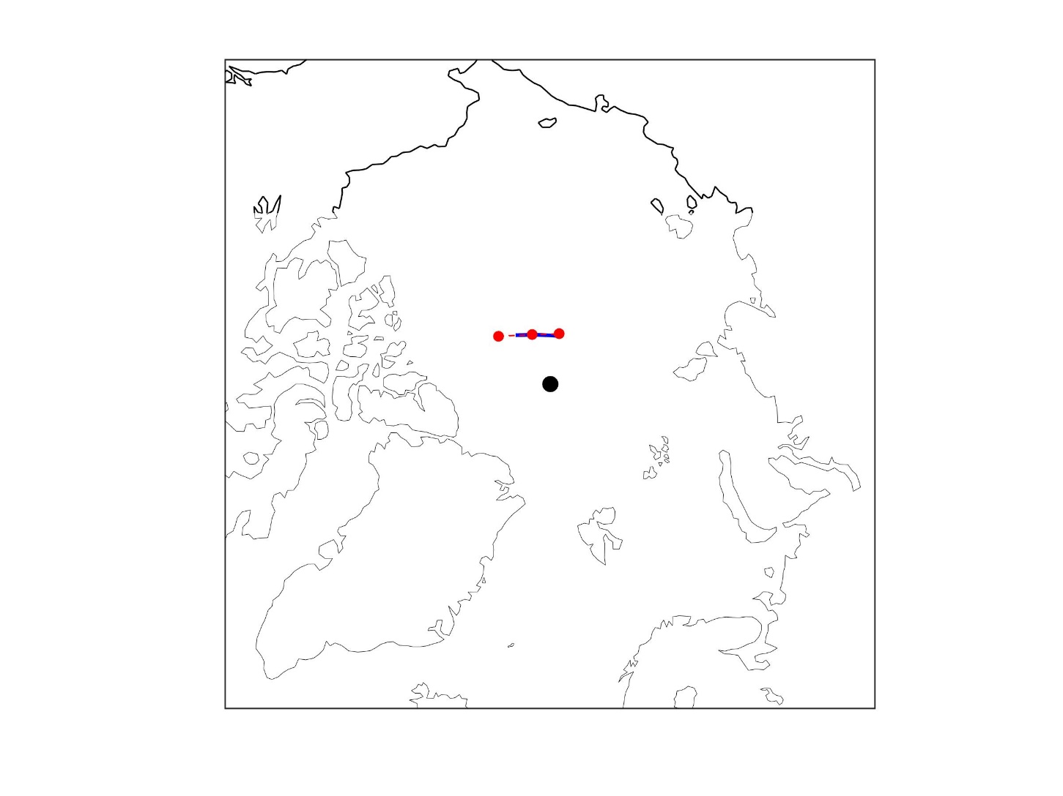
Report on IGRF-12: Location of the North Dip Pole
-- IGRF-12
-- CM
.North geographic pole.
2010
2020
2015
Distance between IGRF-12 prediction and CM4 in 2019 is 18.14 km on the WGS84 ellipsoid.

Slide 19
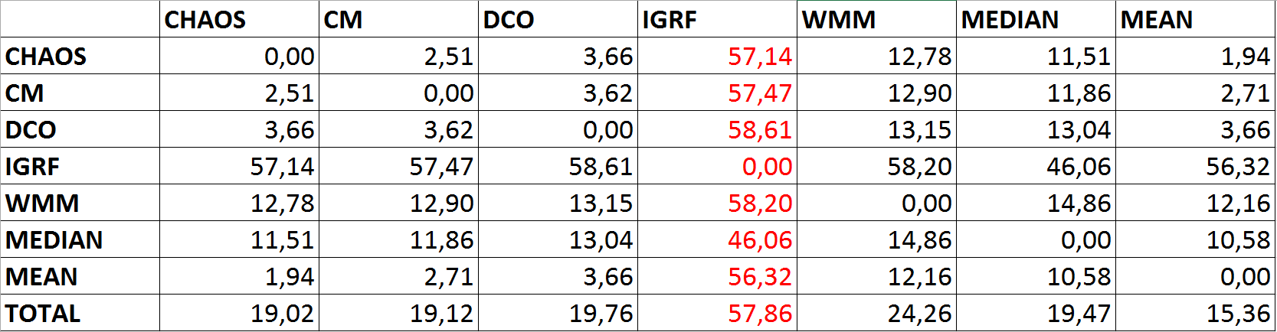
Report on IGRF-12: RMS in 2018.0

Slide 20
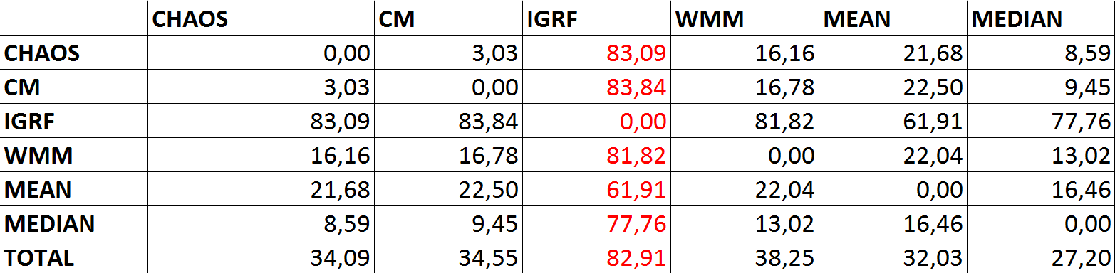
Report on IGRF-12 :RMS in 2019.0

Slide 21
WDMAM
World Digital Magnetic Anomaly Map
Current task force is chaired by J. Dyment and Co-chair by M. Catalan
Revision (WDMAM 2.0) was released in 2015.
A web site wdmam.org is available to freely download the map.
The map is now updated on a regular basis.
New compilation for the Caribbean Sea (A. Garcia), other updated compilations await to be included.

Slide 22
WDMAM : task force
Chair and co-chair
Jérôme Dyment (Chair, CGMW representative), jdy@ipgp.fr
Manuel Catalan (co‐chair), mcatalan@roa.es
Current task force
Mike Purucker, michael.e.purucker@nasa.gov
Erwan Thebault, erwan.thebault@univ-nantes.fr
Mohamed Hamoudi, hamoudi@usthb.dz
Takemi Ishihara, t-ishihara@aist.go.jp and Shigeo Okuma, s.okuma@aist.go.jp
Vincent Lesur, lesur@ipgp.fr
Tamara Litvinova, tamara_litvinova@vsegei.ru
Brian Meyer Brian.Meyer@noaa.gov
Dhananjay Ravat, ravat@geo.siu.edu
Joaquim Luis, jluis@ualg.pt
Angelo de Santis, angelo.desantis@ingv.it
Mark Pilkington, mpilking@NRCan.gc.ca
Yoan Quesnel, yoan.quesnel@cerege.fr
Foteini Vervelidou, foteini@gfz-potsdam.de

Slide 23
WDMAM: download

Slide 24
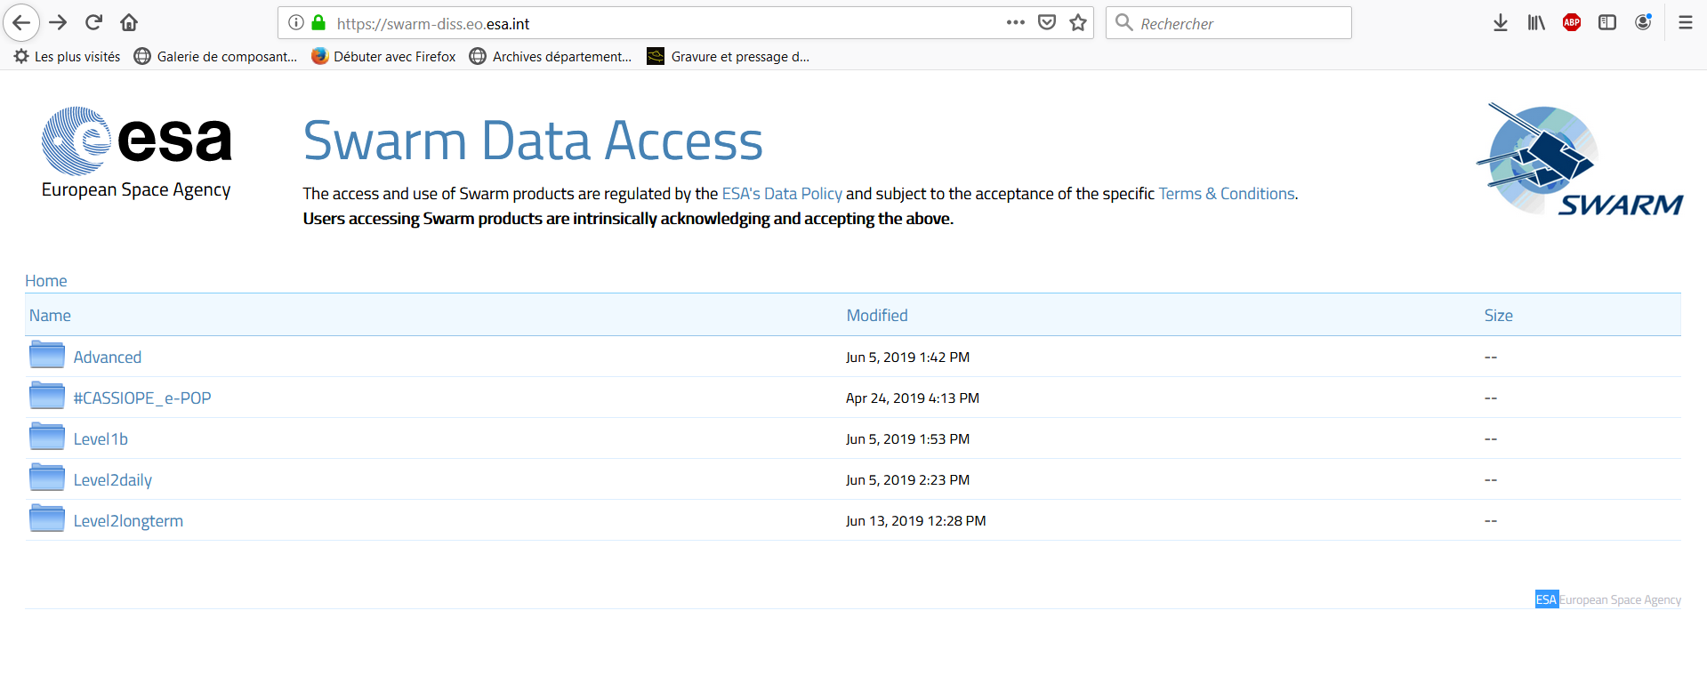
Data available for field modelling
SWARM A, B and C:
Swarm magnetic field measurements might be dowloaded by FTP.
Models for epoch 2015 and later can be compared with the Comprehensive model and/or the dedicated core field model (prior to January 2019).
DMSP
F-16, F-17, F-18: high-resolution ephemeris now available
ePOP
CryoSat
GOCE/GRACE
CSES

Slide 25
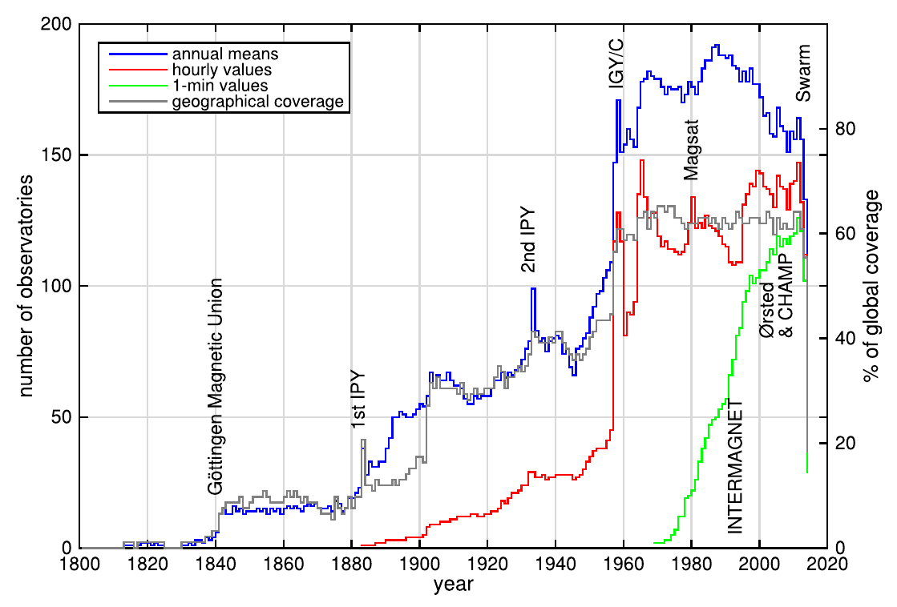
Data available for field modelling

Slide 26
IGRF-13 Plans
Model parameterization and definition similar to IGRF-12 to avoid undesirable step in the IGRF coefficients.
Call for candidates done in April 2019 via gpmag list.
Oct 2019: Deadline for submission of candidates
Nov 2019: Evaluation of candidates
By Jan 2020: Release of IGRF-13.
A special issue will be published in Earth Planets and Space: https://earth-planets-space.springeropen.com/igrf13
Dead line: 30th January 2020

Slide 27
IGRF-13 task force
BGS: W. Brown (wb@bgs.ac.uk), C. Beggan (ciar@bgs.ac.uk)
DTU: C. Finlay (cfinlay@space.dtu.dk), N. Olsen (nio@space.dtu.dk)
GFZ Potsdam: M. Rother (rother@gfz-potsdam.de), C. Stolle (cstolle@gfz-potsdam.de)
ISTerre Grenoble: N. Gillet (nicolas.gillet@univ-grenbole-alpes.fr)
NOAA/NCEI: A. Chulliat (arnaud.chulliat@noaa.gov), P. Alken (alken@colorado.edu), M. Nair (manoj.nair@noaa.gov)
University of Newcastle: F. Lowes (f.j.lowes@newcastle.ac.uk)
Kyoto University: H. Toh (tou.hiroaki.7u@kyoto-u.ac.jp)
IPGP: G. Hulot/P. Vigneron/A. Fournier/V. Lesur (gh@ipgp.fr)
LPG Nantes: E. Thebault/B. Langlais (erwan.Thebault@univ-nantes.fr)
Univ. Nantes / Univ. Strasbourg: Ingo Wardinski
Univ. Leeds: P. Livermore (P.W.Livermore@leeds.ac.uk)
Please contact alken@colorado.edu if you want to volunteer

Slide 28
IGRF-13 Plans: Contributors
Univ. Complut. Madrid (Leader: F. J. Pavon-Carrasco).
Univ. Nantes/EOST (Leader: I. Wardinski)
IPGP (Leaders: G. Hulot, V. Lesur and A. Fournier).
BGS (Leader: C. Beggan)
NOAA (Leader: A. Chulliat)
DTU Space (Leader: C. Finlay)
ISTerre (Leader: N. Gillet)
NASA ? (Leader: T. Sabaka?)
CEA (Leader: Y. Yang)
GFZ (Leader: C. Stolle)
Univ Leeds (Leader: P. Livermore)
Other teams must send a letter of intent by August 1st 2019 with short description.

Slide 29
IGRF Coefficient Uncertainties
IGRF-13 call “Suggested Additional Information”
  Please give some indication of the uncertainties of the resulting set of coefficients and how these were inferred (e.g. co-variances, possible known biases, etc)
Why are we asking for coefficient uncertainties?
Does anyone find these useful?
How would we combine uncertainties of candidate models into a final model?
Would it be more useful to provide spatial maps of errors at Earth’s surface, instead of errors on individual Gauss coefficients?

Slide 30
Election of chair and co-chair
Co-chair candidates (will oversee IGRF-14 in 2025)
  Ciaran Beggan, BGS
  Ingo Wardinski, Univ. Nantes / EOST, Strasbourg
Chair candidates
  Patrick Alken, Univ. Colorado

Slide 31
Suggestions for IAGA/IASPEI 2021
Exploring Earth’s magnetic field from space (Joint with DIV-1, 2, and 3)
  G. Hulot and C. Beggan
Lithospheric field modelling and tectonic implications
  J. Dyment and V. Lesur
Planetary magnetic fields and geomagnetic secular variation (Joint with DIV-1 and SEDI)
  W. Brown, I. Wardinski, and C. Finlay

Slide 32

Other business ?

